Slide 1


SAVE WATER
SMART WATER METERING SYSTEM…..
PRIDHVI KRISHNA
SHUBHAM VERMA
Notes:
To view this presentation, first, turn up your volume and second, launch the self-running slide show.

Slide 2



PROBLEM
STATEMENT
HAND
IN
Notes:
The first rule is: Treat your audience as king.

Slide 3








Notes:
and keep the audience’s needs top of mind,

Slide 4





Notes:
But also change the world. (Well, at least your part of the world.)

Slide 5
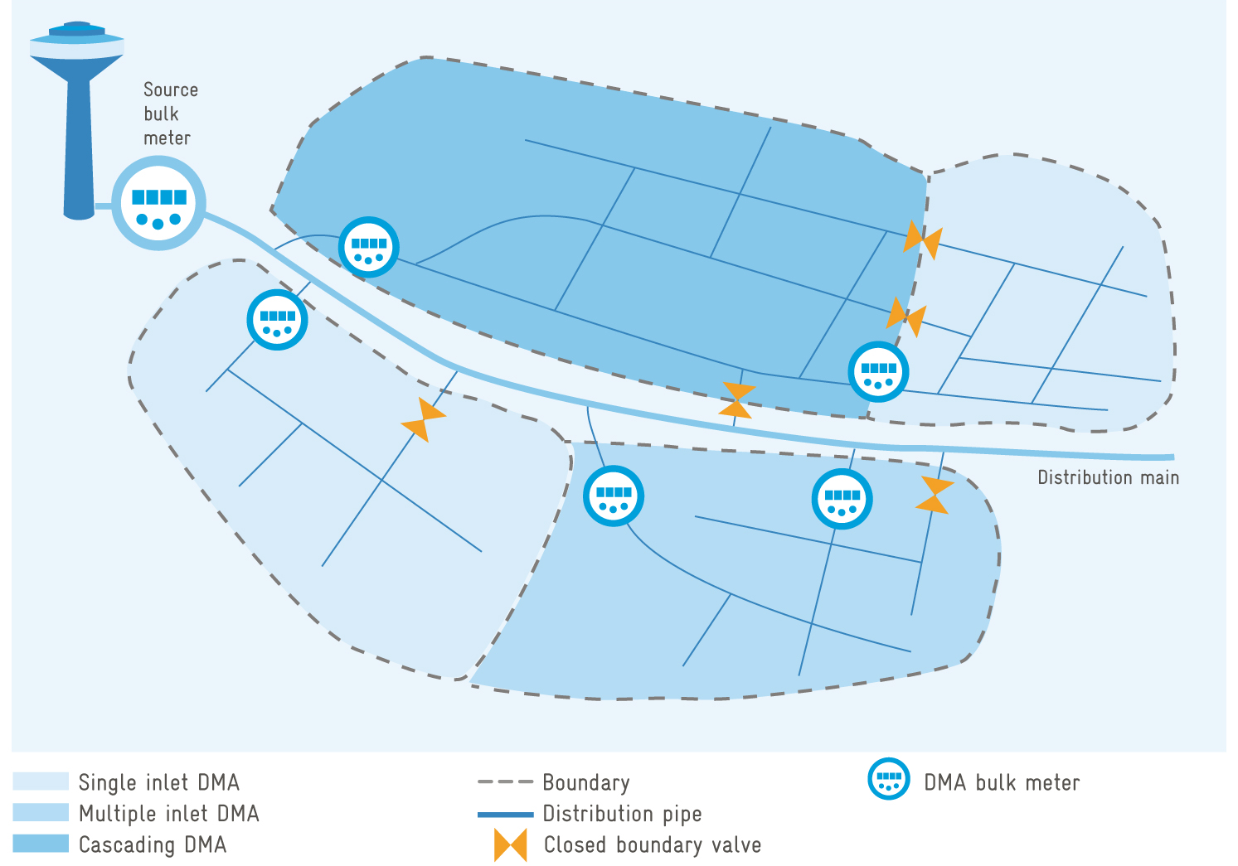

Slide 6

2
OUR
APPROACH
TO
THE
PROBLEM

Slide 7

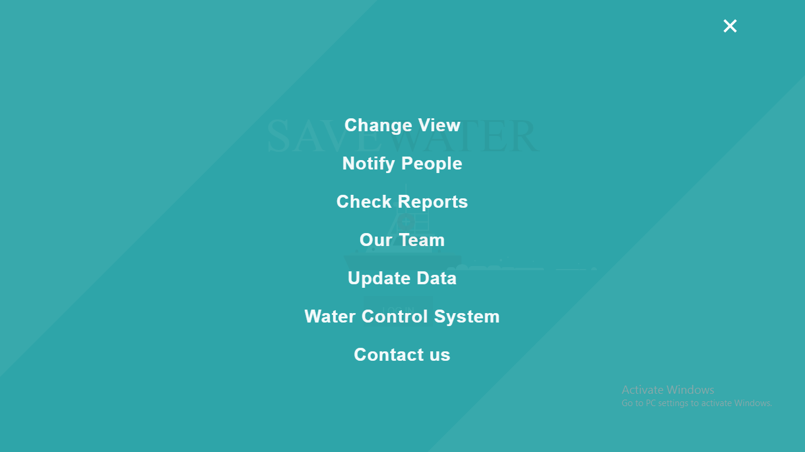
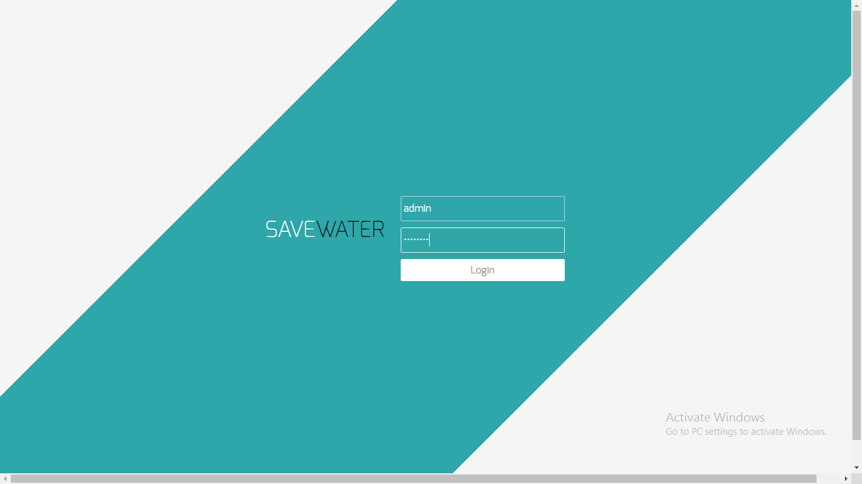
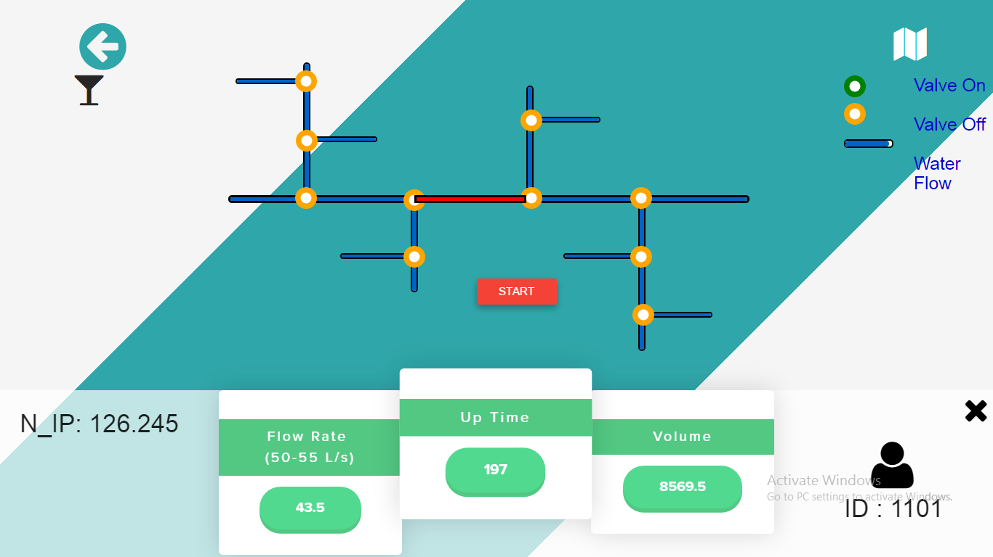
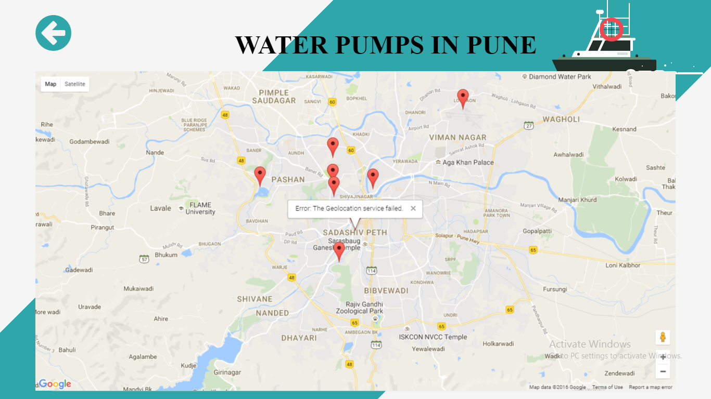
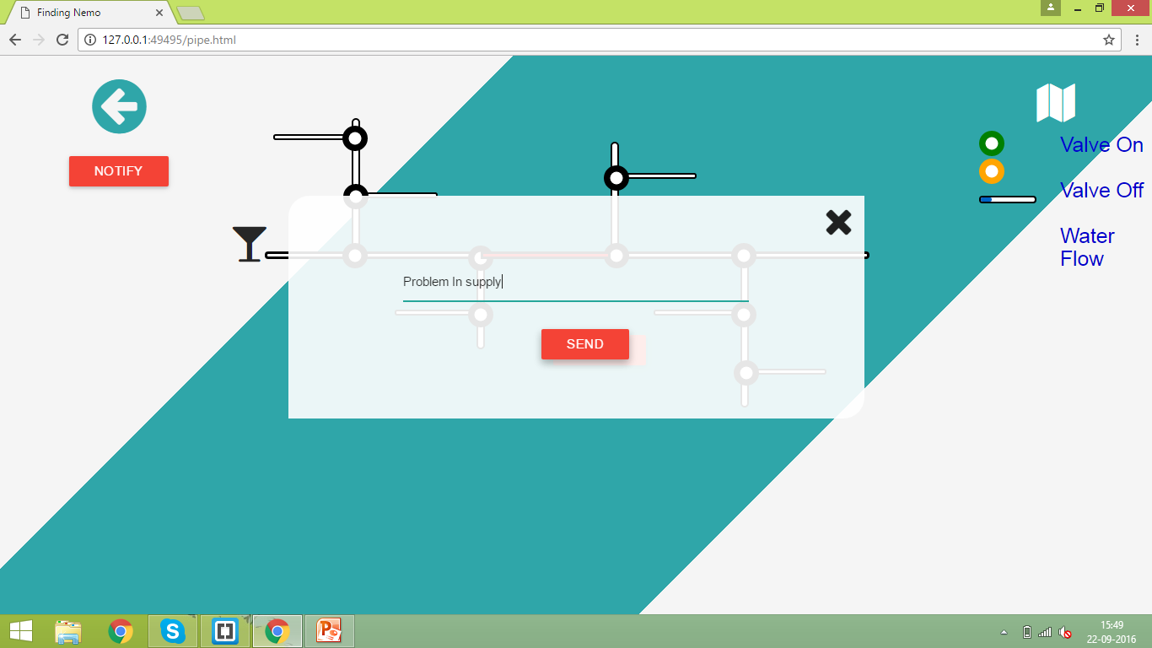
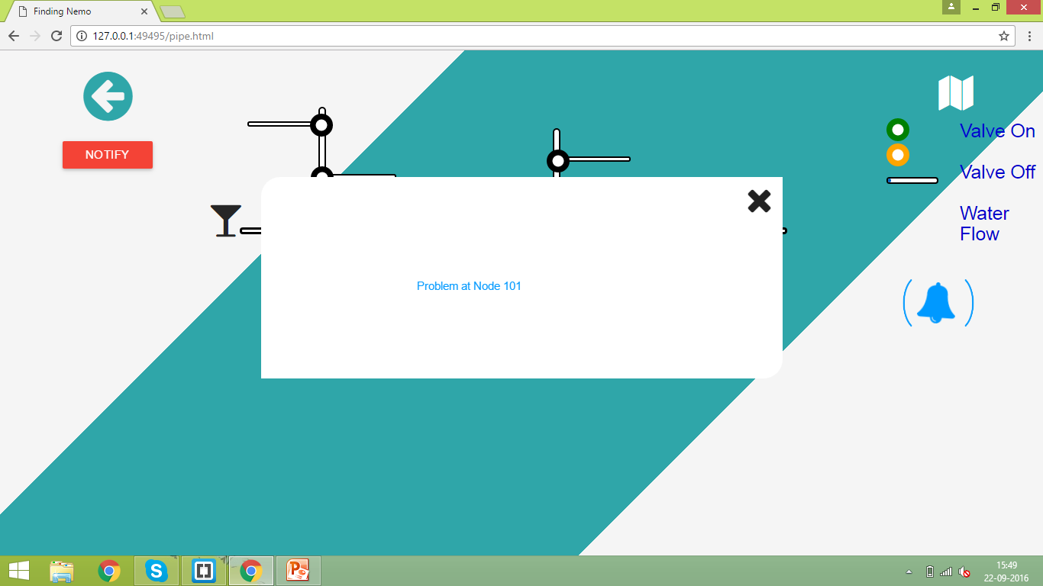
WEB
VIEW

Slide 8

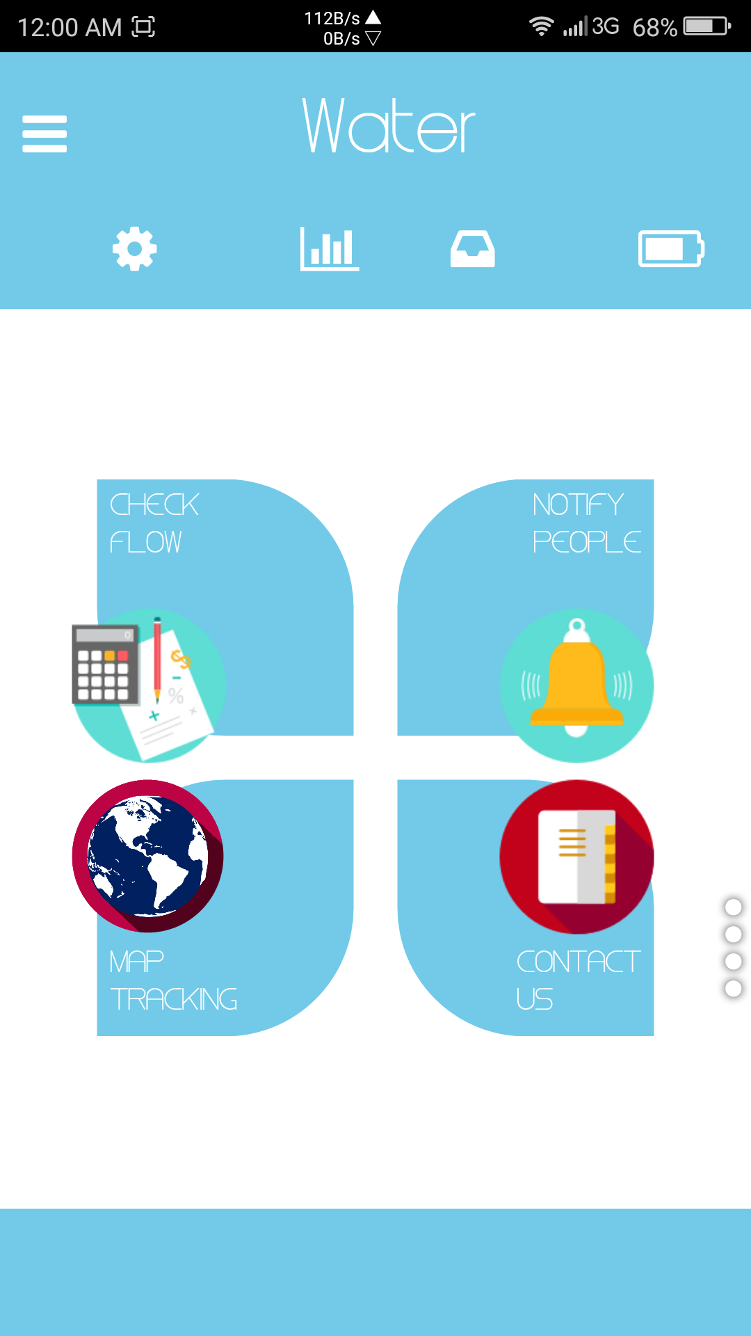


The User’s
View!
Easy to use user interface .
Material design
Full integration with hardware.
Features!

Slide 9


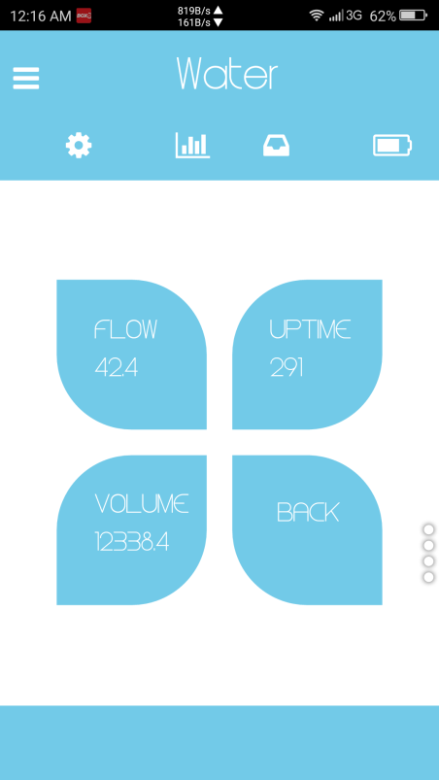
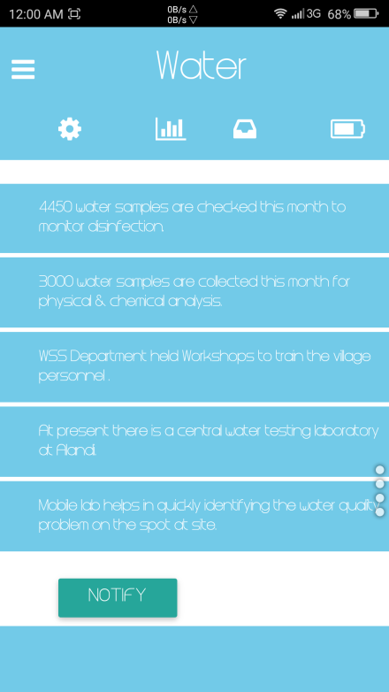
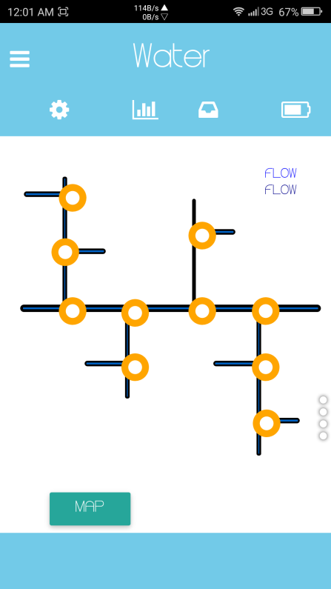
Flow rate of given household
Smart meter
Two way
Notification system
Dynamic map-view
And leakage detection

Slide 10










3
Technology
USED
IN
DEVELOPMENT
Notes:
Rule number 4: Practice design, not decoration.

Slide 11



TECHNOLOGY USED
Raspberry Pi
Three Axis Magnetometer
USB SIM Module

Slide 12




Tools & Technologies!
… to build Cross Platform Apps
…it’s a cross-platform JavaScript library
…it’s a cross-browser library of CSS animations.
…used to build the App.

Slide 13



4
HOW
ARE
WE
GOING
TO
IMPLEMENT
Notes:
The next rule is: Help them see what you are saying.

Slide 14
Notes:
As tempting as it is to fill your slides with stuff, often de-decorating is the best policy.

Slide 16

















5
COST
EFFECTIVE
SYSTEM
Notes:
The last rule is: Cultivate healthy relationships (with your slides and your audience)

Slide 17

COST EFFECTIVENESS AND FUTURESCOPE
TOTAL COST OF SMART METER (PI + METER +MODULE)
LESS THAN RS 1000
MAINTAINENCE COST
AS INSTALLATION IS A ONE TIME JOB, MAINTAINANCE IS EASIER AS PI IS PROVIDED WITH IP66 WATERPROOF CASING.
REGULAR SOFTWARE UPDATION

Slide 18
THANK YOU

